Slide 1
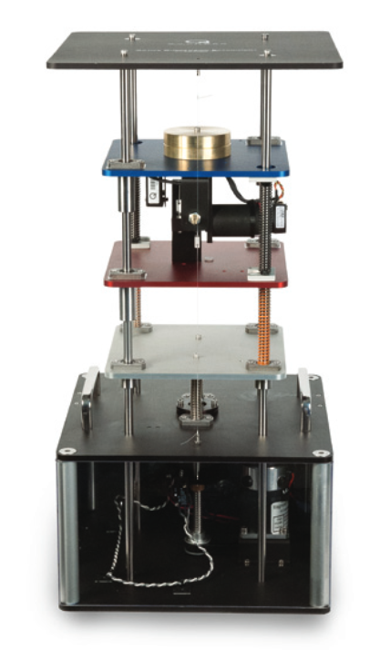
Introduction to Model Predictive Control Workshop
CSSC at UT Dallas
Juned Shaikh and Michael Lingad
May 2nd, 2025

Slide 2
Model Predictive Control Workshop
Intro to MPC
Components to MPC
Quarter Car MPC Example
Drawbacks of MPC

Slide 3
What is Model Predictive Control (MPC)?
- A receding-horizon optimal control framework that uses a dynamic model of a system to predict the future response of the system
- By solving a finite-time horizon, open-loop, optimal control problem using the current state of the system, MPC determines a sequence of control decisions which minimize the specified cost function over the prediction horizon
- The first element of this control sequence is applied to the system and the procedure is repeated at the next time instance.

Slide 4
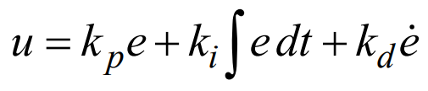
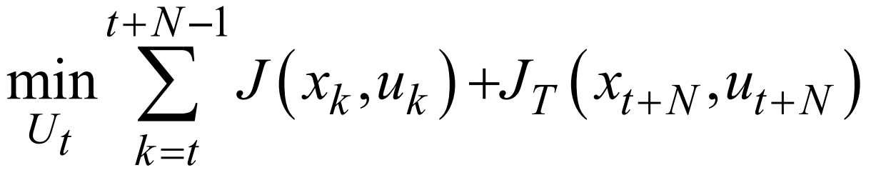
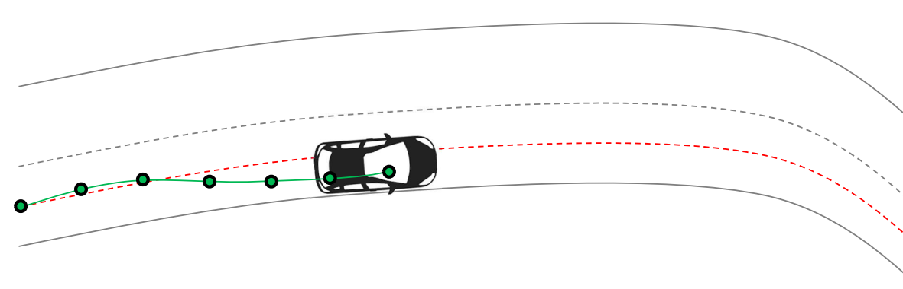
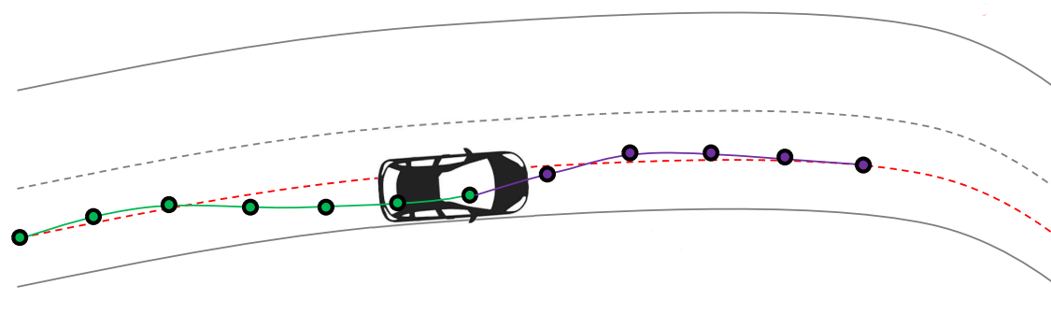
Car Analogy PID vs. MPC
Steering is only based on past tracking error
Drive using side view and rear mirrors
Steering is based on past tracking error and looking ahead
Drive using side view, rear mirrors, and looking ahead

Slide 5


Car Analogy PID vs. MPC
Weakest PID fan vs. Strongest MPC enjoyer

Slide 6
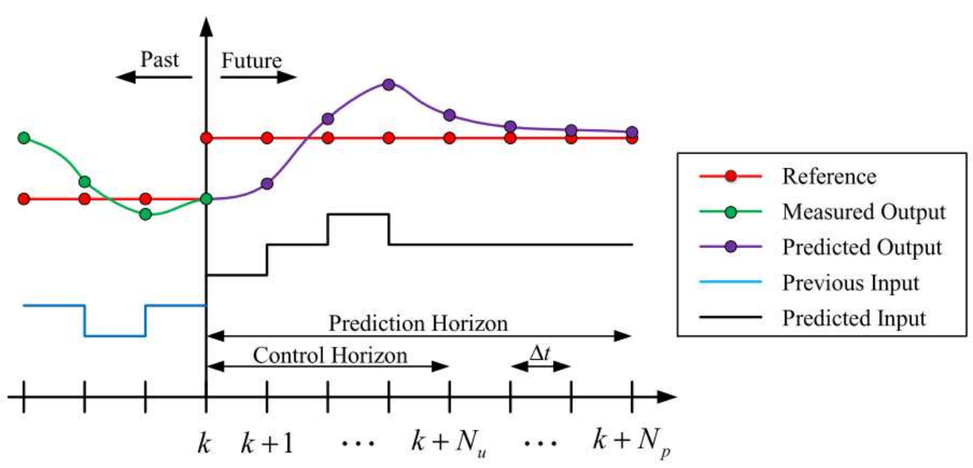

Slide 7
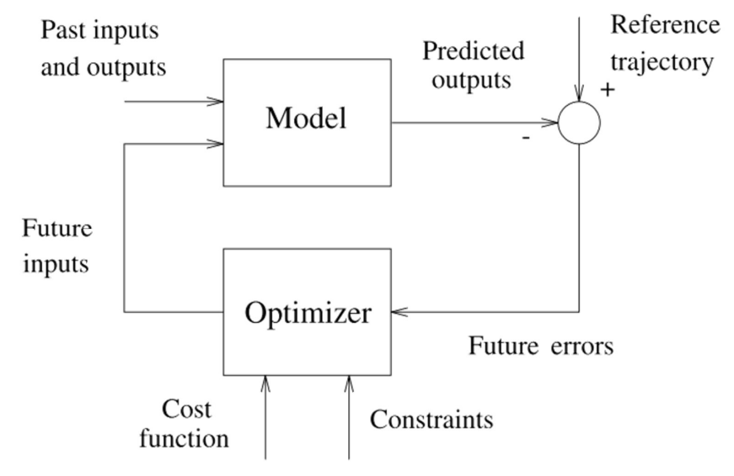

Slide 8
Components to MPC
Model: Need a mathematical model that captures the system. A good model should enable easy predictions, result in an easy optimization problem, and faithfully react the physical system. Ideally, we want a linear model for the reasons above.
Optimization Problem: A quadratic cost function is often minimized since there is one minimum or maximum
Constraint Handling: Allows for the direct embedding of limits in the control input, states, and output.

Slide 9
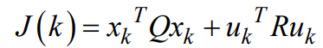
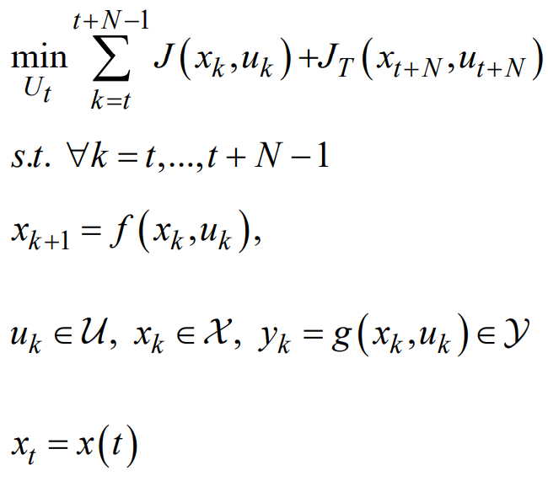
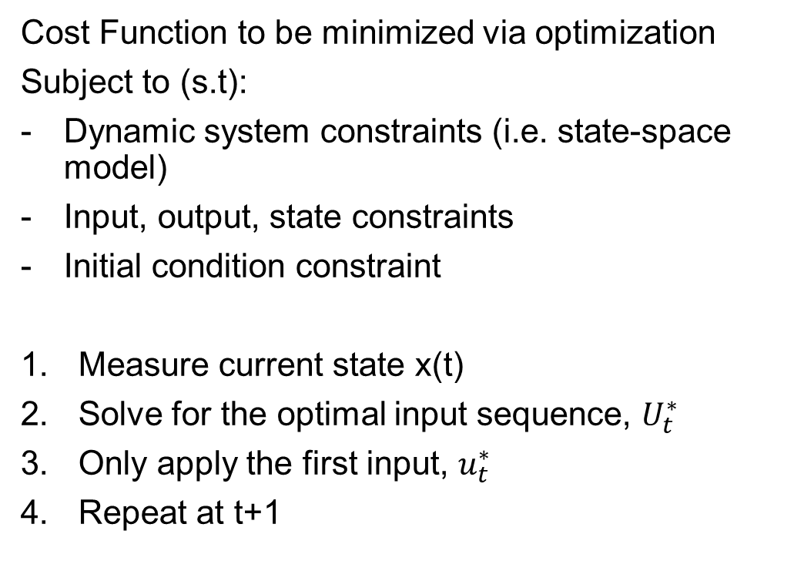
Mathematical Formulation
Cost Function to be minimized via optimization
Subject to (s.t):
Dynamic system constraints (i.e. state-space model)
Input, output, state constraints
Initial condition constraint
Measure current state x(t)
Solve for the optimal input sequence, $U_{t}^{∗}$
Only apply the first input, $u_{t}^{∗}$
Repeat at t+1

Slide 10
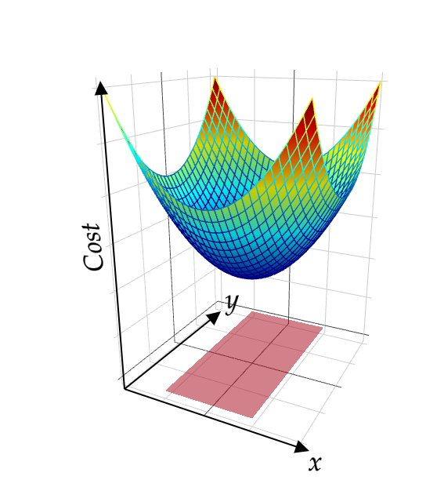
Optimization Problem

Slide 11
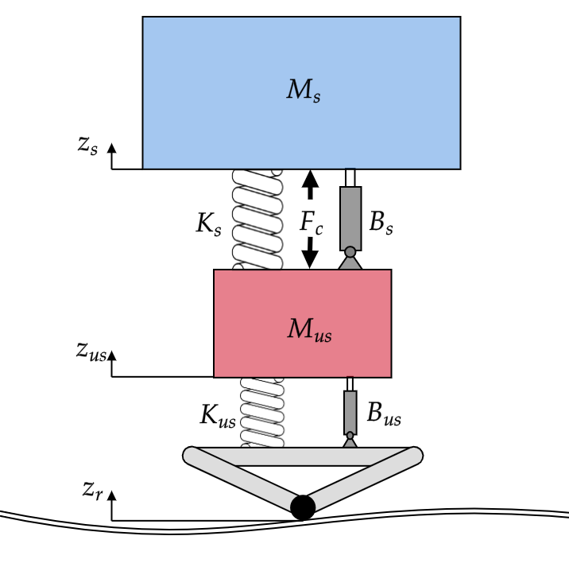
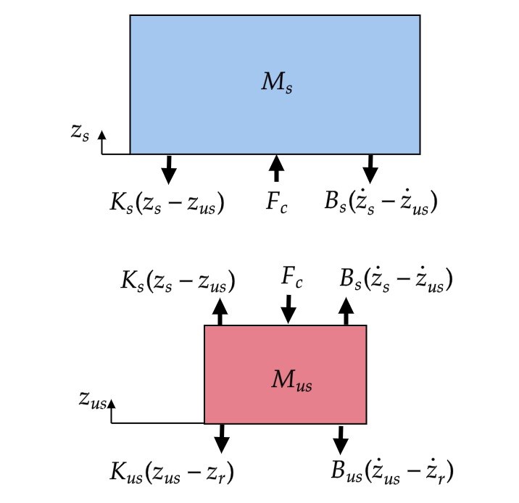
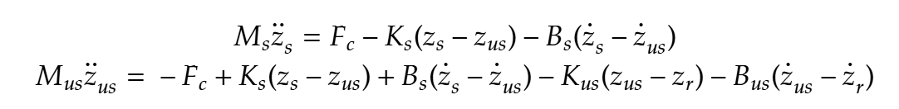
Quarter Car Model

Slide 12
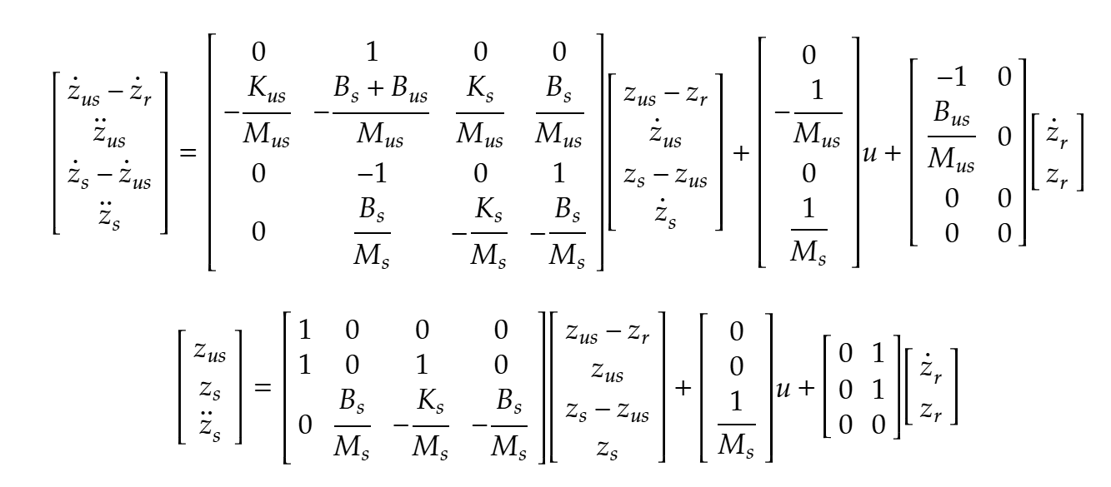
Quarter Car Model
Task 1: Define the quarter car model dynamics & perform open-loop simulation
Task 2: Find the gains for PD controller that stabilizes the system

Slide 13
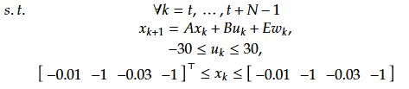
MPC Problem Formulation
Task 3: Find the gains for the MPC cost function

Slide 14
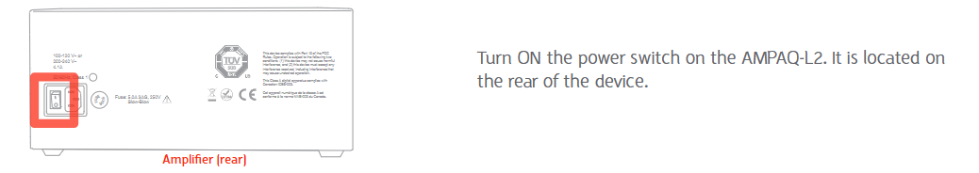
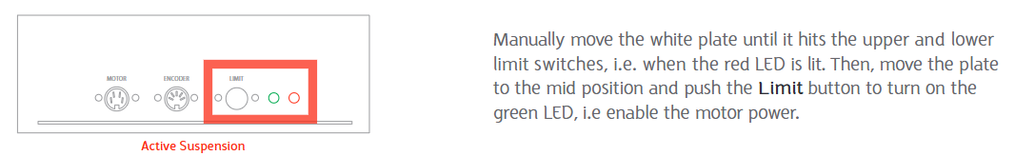
MPC Experiment
Steps to start the test bed:
1.
2.

Slide 15
Drawbacks of MPC
Feasibility: How can we guarantee that the optimization problem has a valid solution that satisfies all constraints?
Stability: How can we guarantee that the controller makes the system closed-loop stable?
Real-time Implementation: Solving an optimization problem can take a lot of time, can we ensure that the we solve the problem fast enough for control?
Model Sophistication: The effectiveness of the controller is sensitive on the plant model, how are we able to produce a good enough model that describes our system?
These questions are answered if you take the MPC course!

